Slide 1
FATIMA Daily Weather Briefing
July 22
WRF forecast
Zheqi Chen

Slide 2
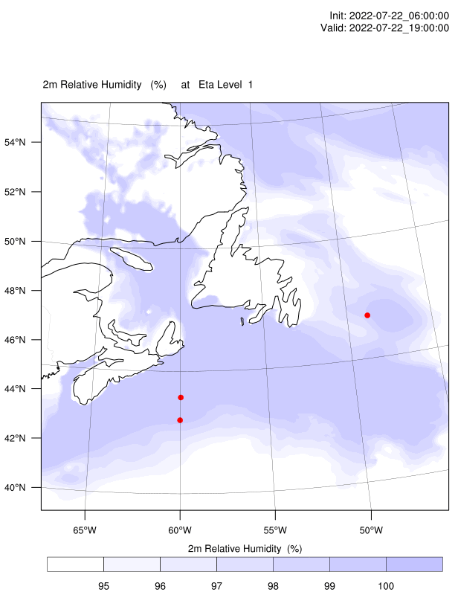
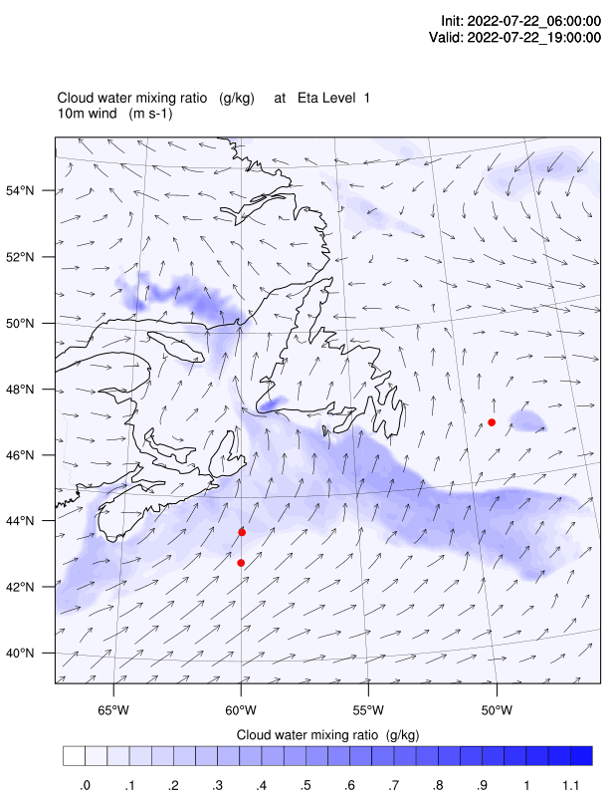
4m cloud water & 10m wind
Droplet number = 10^8/m^3 over water

Slide 3
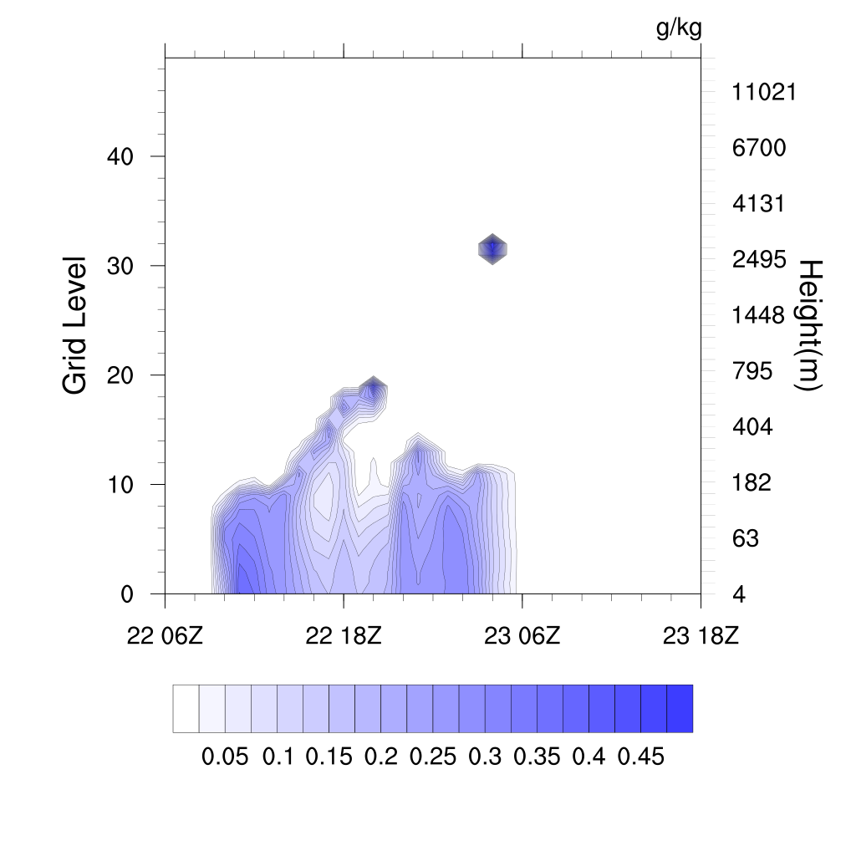
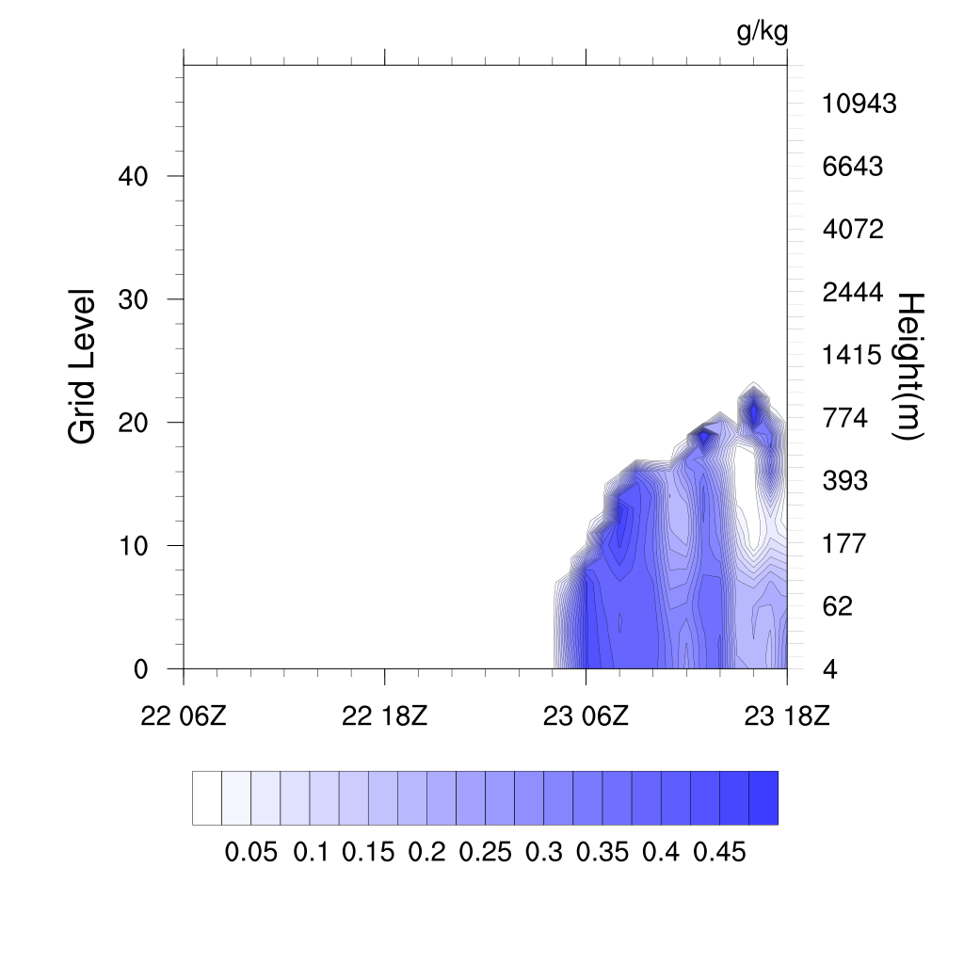
First 12 hours of the plot is spin up time
Sable Island
Hibernia oil platform

Slide 4
 | SI today | SI tomorrow | Condor today | Condor tomorrow | Hibernia today | Hibernia tomorrow
10m Wind speed (m/s) | 7-9 | 6-7 | 7-9 | 6-7 | 3-4 | 5-6
Wind direction | SSW | SW | SSW | SW | S | SE
Fog chance | 90% | 90% until morning | 90% | 90% until morning | 50% | 90% from morning
Tomorrow is until 18Z

